Slide 1
Our Clubhouse Antennas and needs
By: Jonathan Graefe AE3JG

Slide 2
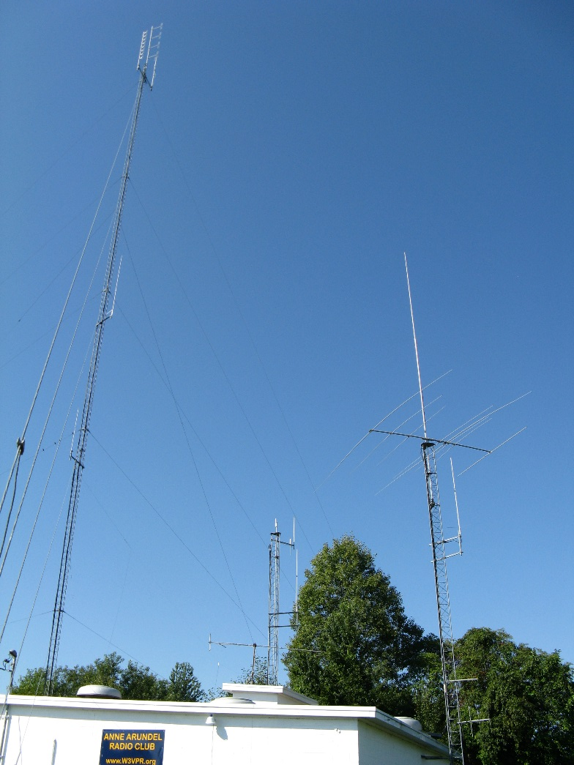
Our Clubhouse antennas
The North and West towers are the oldest towers with the main 190 foot antenna tower added in 2000.
We can operate on every amateur between 70cm to 80 meters. We also have a Mesh node operating on 2.4Ghz and 5Ghz
In total we have 19 antennas

Slide 3
Main Tower Windoms – for the ham shack
North – South Windom
East-West Windom

Slide 4
Top of the Main Tower
444.400Mhz Repeater
223.880 Repeater
147.105 Repeater

Slide 5
Middle of the Main tower
Dual Band 100
ARES Digipeter
145.010
Tri Band 75
223.880 Link to Millersville

Slide 6
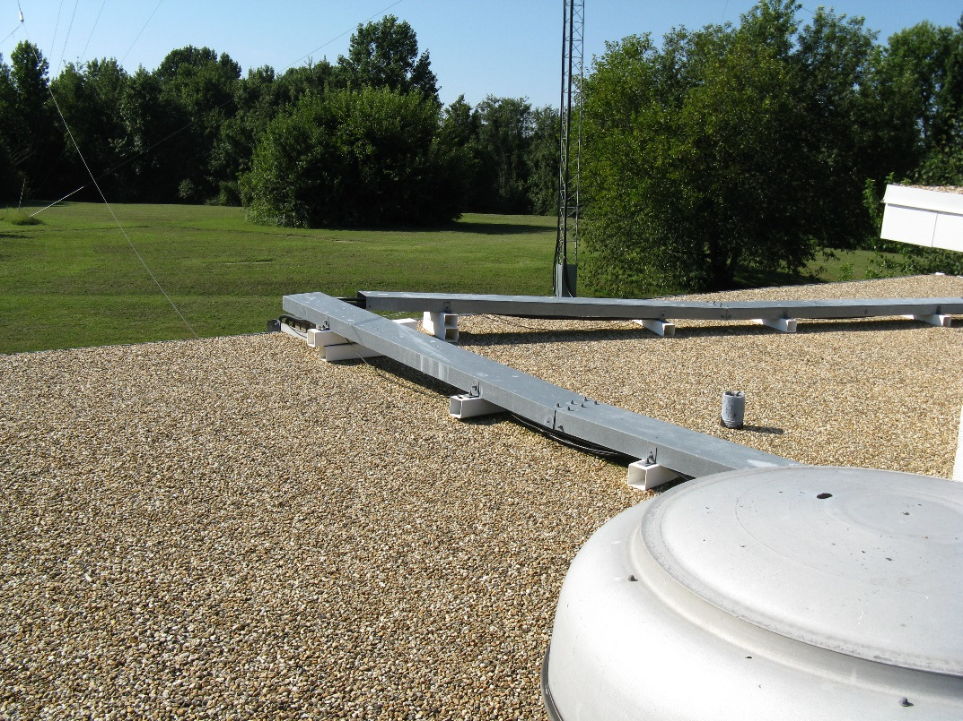
Top of the Club house
Anyone know? Internet?

Slide 7
West Tower
Mount for Dual Band West
Mesh Node 2.4GHz
Mesh Node 5GHz
Tri-band West tower – Ham shack 2m/70cm/1.25m antenna

Slide 8
North Tower
Dual Band North – Club packet station
40/20/15/10m beam – Ham shack
Tri band North – Spare/repeater testing
North County Link to 147.075

Slide 9
Antenna Entrance Point
Antenna Entrance point, all antennas have lightening protection.

Slide 10
Projects North side
Building North side Needs cleaning

Slide 11
Projects HVAC retention
Needs air sealing
Its cold in here during the peak of winter
We sweat during the summer because of needs like this.

Slide 12
Projects West Tower
West tower coax needs to be re-routed via the grounding panel in the repeater room. Project is underway because we had a volunteer to head the operation.
Need to bring the west tower base up to grade.

Slide 13
Projects
Heat pump needs a good cleaning.

Slide 14
Projects - Grounds
Old Telephone pole was here. Now is a big hole. Need someone to volunteer to fill it with something other than this pipe.
Seed a little grass.

Slide 15
Other Clubhouse needs
Post office box pickup
Tower maintenance crew lead
Historian to preserve and scan club documentation
Think about reaching out for a position in the club. These board positions will become available for next year:
President
Vice President
Secretary
Director

